Slide 1
Lesson 01 – Python Introduction
Shyam Bhagat

Slide 2
Python Features
Very widely used Language
Python is now a very widely used general-purpose, and a interpreted, object oriented, high-level programming language.
Simple and Easy to Learn
Python is a simple and minimalistic language in nature
Reading a good python program should be like reading English
Its Pseudo-code nature allows one to concentrate on the problem rather than the language
Python is Free and Open Source
The Python interpreter is developed under an OSI-approved open-source license, making it free to install, use, and distribute, even for commercial purposes. Free & Open source
Maintained by the Python community

Slide 3
Python Features
Cross-platform Language and Portable
Python works on different platforms like Windows, Linux, Mac, etc. Because Python code is interpreted and not compiled into native machine instructions, code written for one platform will work on any other platform that has the Python interpreter installed.
Supports the Multiple Programming Paradigms
The language also supports the multiple programming paradigms
Object Oriented programming paradigms
Procedure Oriented programming paradigms
Functional programming paradigms

Slide 4
Python Features
Huge Set of Libraries
Python Libraries has a huge set of useful libraries used in almost all areas. From Data Science to Artificial Intelligence, from creating Web Applications to Office Automation, who will get libraries for every task freely available on the Internet and eliminate the need for writing codes from scratch.
There are over 137,000 python libraries present till September 2020.
General Purpose Programming Language
Standalone Applications (CUI & GUI)
Dynamic Web Applications (Instagram, Google, Spotify, Netflix, Uber, Dropbox, reddit, Quora, Facebook etc)
Large Scale Enterprise Applications (Banking App, Stock App etc)
Data Science and Machine Learning Implementations
IoT and Machine Learning Applications
Artificial intelligence, Data science and Natural Language Processing,

Slide 5
Python Features
Inbuilt Memory Management
Python handles most of the hard parts of memory management for you. It keeps track of the number of references to each object in the program. When an object's reference count drops to zero, the garbage collector automatically frees the memory from that particular object.
But it's not that Simple
For all its syntactical simplicity, Python supports most constructs that would be expected in a very high-level language, including complex dynamic data types, structured and functional programming, and object-oriented programming.

Slide 6
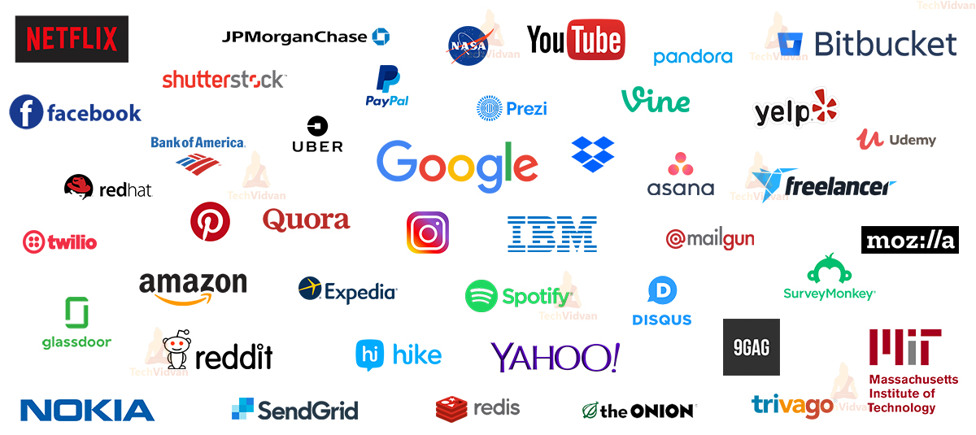
Major Companies using Python

Slide 7
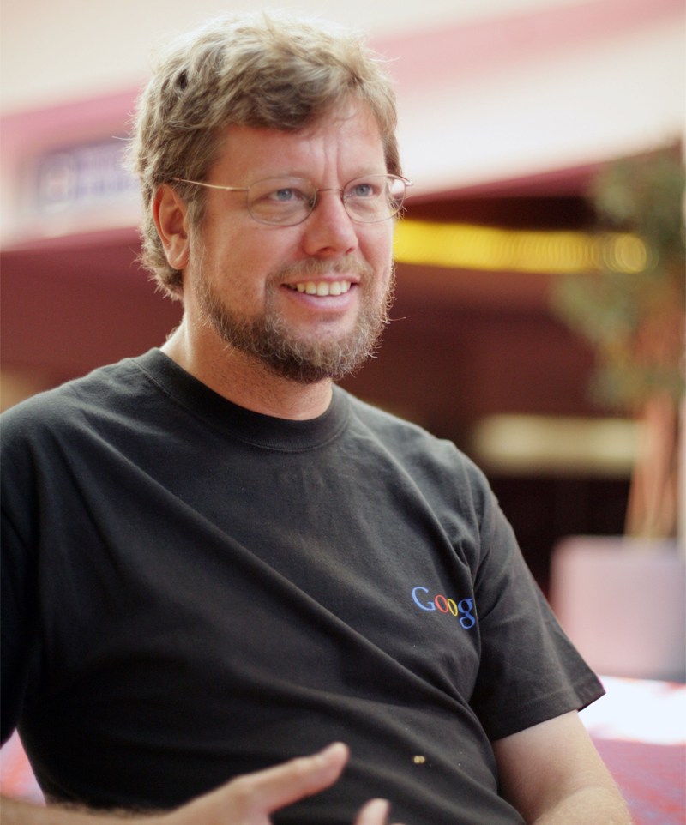
History of Python
Created in 1989 by Guido van Rossum
Created as a scripting language for administrative tasks
Based on All Basic Code (ABC) and Modula-3
Added extensibility
Named after comic troupe Monty Python
Released publicly in 1991
Growing community of Python developers
Evolved into well-supported programming language
Python Web site at www.python.org
Primary distribution center for Python source code, modules and documentation

Slide 8
History of Python
Python 0.9 (1991)
1.0 (1994)
1.5 (1998)
1.6 (2000)
2.0 (2000)
2.1 (2001)
2.2 (2001)
2.3 (2003)
2.4 (2004)
2.5 (2006)
2.6 (2008)
2.7 (2010)
3.0 (2008)
3.1 (2009)
3.2 (2011)
3.3 (2012)
3.4 (2014)
3.5 (2015)
3.6 (2016)
3.7 (2018)
3.8 (2019)
3.9 (2020)

Slide 9
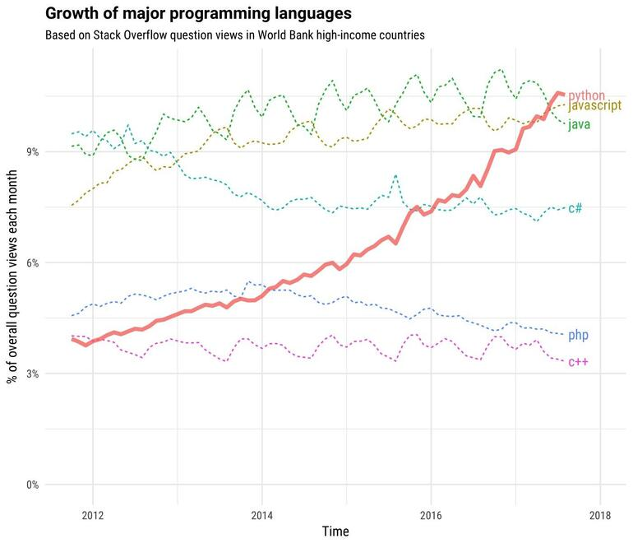
Growth of Python

Slide 10
Compiled vs Interpreted
Compiler Language
A compiler takes the source code and turns the code into machine understandable form which is stored in the single or multiple executable files.
If program has any syntax or technical errors in any part of the code, compiler will not allow to build executable file.
Compiled programs run faster because compilation is done before execution.
Memory requirement is more due to the creation of object code.
Source code => Compiler => Machine Code => Output
e.g: C,C++
Interpreter Language:
An interpreter runs source code line-by-line. It looks at each line and evaluates it just before running it.
Interpreter takes your code and reads it line by line and points out the error whenever it encounters an error, it won't read your next line if you do not remove the error.
Interpreted programs run slower because compilation and execution take place simultaneously.
Memory requirement is less.
Source Code => Interpreter => Output
e.g: Perl, Python, Matlab

Slide 11
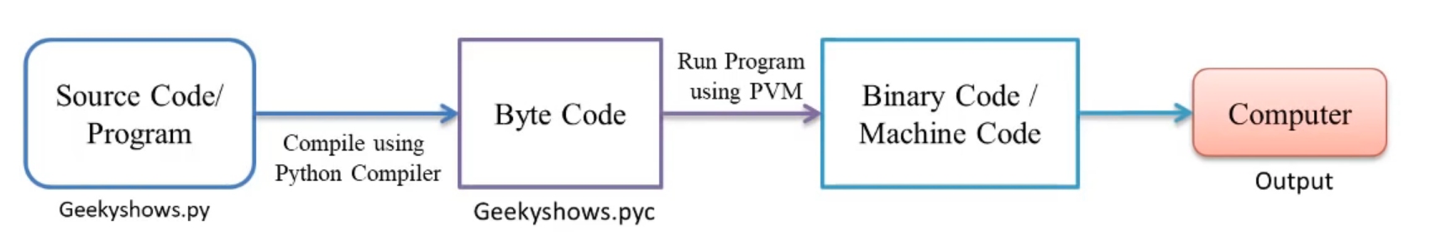
How Python Program works?
Write Source Code/Program.
Compile the Program using Python Compiler.
Compiler converts the Python Program into Byte Code.
Computer/Machine cannot understand the Byte code so we need to convert the Byte Code into Machine Code using PVM (Python Virtual Machine).
PVM uses an Interpreter which understands the Byte Code and convert it into Machine Code.
Machine Code instructions are then executed by the processor and results are displayed

Slide 12
Python Compilers
A Python Compiler converts the program source code into ByteCode.
Type of Python Compilers
CPython
Jpython/Jython
PyPy
RubyPython
IronPython
StacklessPython
Pythonxy
AnacondaPython

Slide 13
Byte Code
Byte Code represents the fixed set of instructions created by Python Developers representing all type of operations like Arithmetic Operations, Comparison operations, Memory related Operations etc..
The size of each byte code is 1 byte or 8 bits. We can find byte code instruction in the .pyc file.
The python interpreter is stack-based and once source is compiled corresponding .pyc are ready in the same directory (in case of python 2.x). With python 3.x a new __pycache__ directory is created for the source and all compiled Bytecode files are placed underneath.

Slide 14
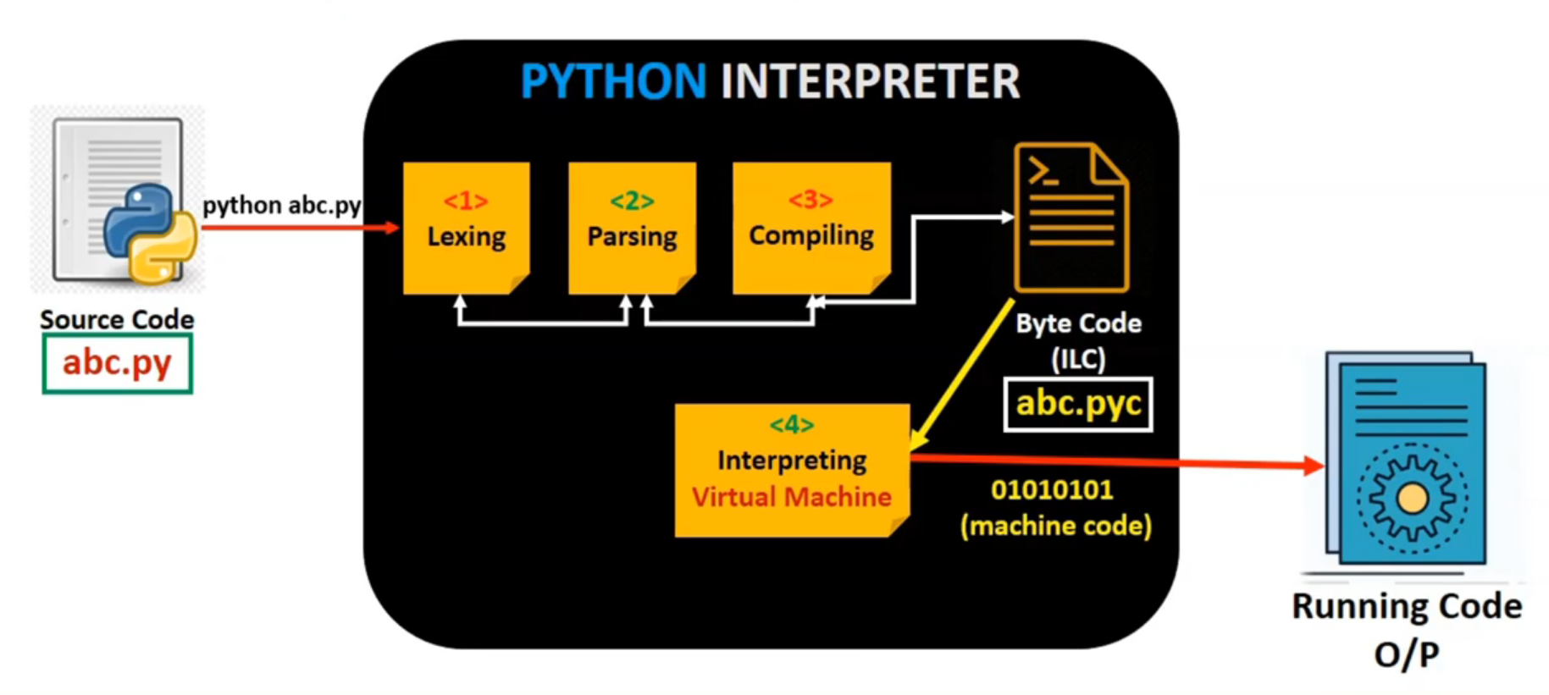
How Code is converted in Byte Code?
Lexing - The Lexer breaks the line of code in tokens
Parsing - The Parser uses these tokens to generate a structure, called Abstract Syntax Tree to depict the relationship between these tokens.
Compiling - The Compiler turns this AST into code object(s).
Interpreting - The Interpreter executes each code object.

Slide 15
Setting up Python Programming Environment
Python 3.8
VS Code
Python extension for VS Code
Microsoft Visual C++ 14.0 Build Tools

Slide 16
IDE for Python
VS Code
IDLE
PyCharm
Spyder
Thonny
Atom

Slide 17
Setting Environment in Python
Step 1 – Install the 3.x Binaries from python.org
Step 2 – Install pip to Manage Your Python Packages
python -m pip install -U pip
Step 3 – If PIP is already install please check for latest update.
pip install --upgrade pip
Step 4 – Install virtualenv to Create Local Python Environments for Your Projects
pip install virtualenv

Slide 18
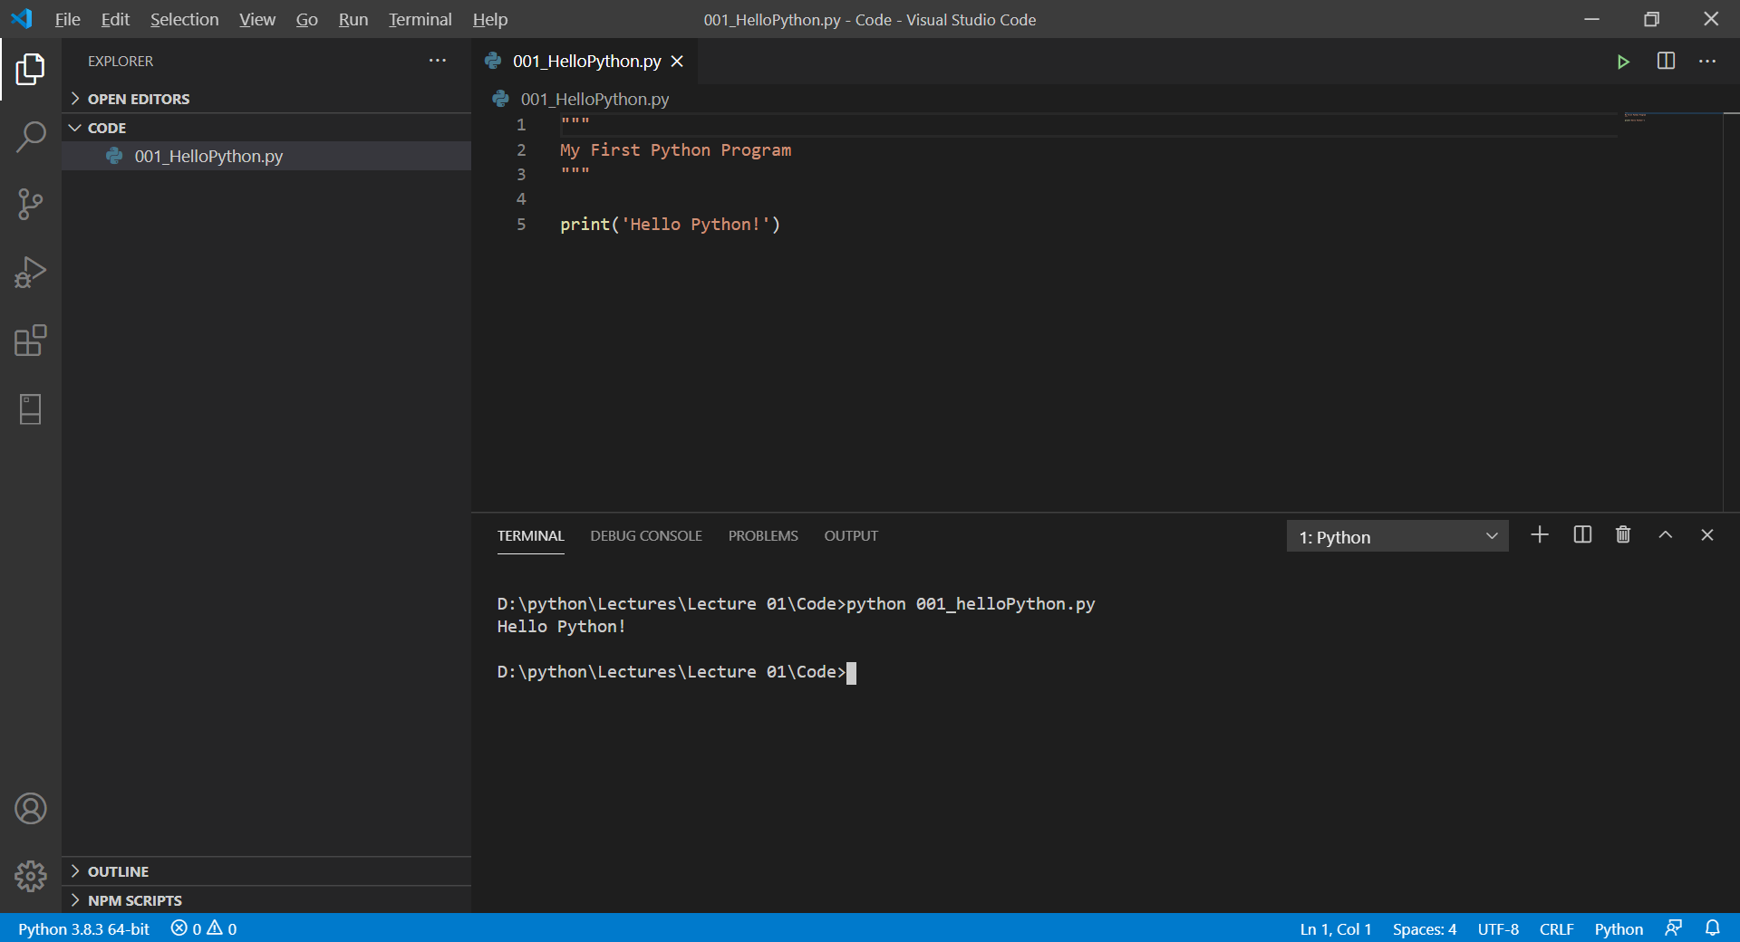
Writing First Python Program

Slide 19
Execute Python
Python “filename.py”

Slide 20
Declaring Variables
Variable Name Rules
A variable can have a short name (like x and y) or a more descriptive name (age, carname, total_volume). Rules for Python variables:
A variable name must start with a letter or the underscore character
A variable name cannot start with a number
A variable name can only contain alpha-numeric characters and underscores (A-z, 0-9, and _ )
Case Sensitive
Variable names are case-sensitive (age, Age and AGE are three different variables)

Slide 21
Assigning Values in Variables
Single Assignment
Multiple Assignment with Same Value
Multiple Assignment with Different Value
Output Variables
Strongly Typed
Dynamically Typed
Variables can hold values of any type
Variables can hold different types at different times

Slide 22
Local and Global Variables
Global Space
What you “start with”
Stores global variables
Also modules & functions
Lasts until you quit Python
Call Frame
Variables in function call
Deleted when call done
Heap Space
Where “folders” are stored
Have to access indirectly

Slide 23
None and Deleting Variables
None will free memory whatever it referenced but keep the name around even though it’s just referencing None (which is a type, NoneType) Call Frame
del x will completely remove both the name and what it referenced. If you thereafter try to use x an NameError will be thrown.

Slide 24


